Slide 1
Who Must/Should File?
IRS Pub 17 – Chapter 1
IRS Pub 501
IRS Pub 4012 – Tab A
IRS 1040 Instructions
NJ 1040 Instructions
Notes:
1

Slide 2
Need To Know
Filing status, age & marital situation
Is taxpayer a dependent? Blind? Disabled?
All sources of income
Excluded or exempt income
Deductions that taxpayer qualifies for
Any withholding or estimated taxes paid
Any carryover capital losses
Prior year state refunds / payments
Notes:
2
Even if taxpayer was a client at site last year, there will not be any carryover data this first year in TaxSlayer. All data must be entered as if this is a new client. We expect that there will be carryover data in future years if the client’s return is entered into TaxSlayer this year

Slide 3
Where To Get Taxpayer Info
Taxpayer interview
Intake/Interview Sheet (Form 13614-C)
Tax documents
Prior year tax return
Notes:
3

Slide 4
Federal and NJ State Filing Requirements are Different
Counselors must reference both Federal and State filing requirements guidelines
A taxpayer may be required to file a Federal Return but not a NJ State Return
A taxpayer may be required to file a NJ State Return but not a Federal Return
Even if a taxpayer is not required to file a tax return, there are cases the return should be filed anyway (e.g. - Tax withheld from pay check)
NOTE: IRS guidelines suggest all returns be filed, even if not required. This is to help prevent fraud

Slide 5
Federal Filing Requirements – Quick Reference
Pub 4012 Tab A
IRS 4012 Tab A Chart A – Income filing minimums for most taxpayers Who Must File
IRS 4012 Tab A Chart B – For Children and Other Dependents
IRS 4012 Tab A Chart C – Other Situations When You Must File
IRS 4012 Tab A Chart D – Who Should File

Slide 6
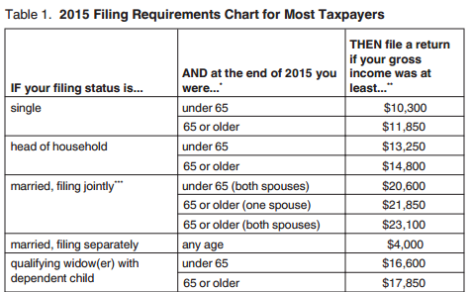
Federal Filing Income Thresholds – Chart A For Most People Who Must File
Pub 4012 Tab A-Chart A
Notes:
Review this chart in Pub 4012
NJ has its own Filing Requirements (in NJ 1040 Instruction booklet)
Note that these numbers change from year to year
6

Slide 7
Principal Sources Of Gross Income
Pub 4012 Tab D
Salaries/
Wages
Sale of Assets
Interest
Pensions/
IRA Distributions
Income
Social Security Benefits
Dividends
Notes:
A more detailed list of taxable & non-taxable income is in Pub 4012 Tab D
7

Slide 8
Federal Filing Requirements
Pub 4012, Tab A Chart A – Footnotes
Any person born on 1/1 is considered to be born in the prior year for Federal tax purposes
But not for NJ tax purposes
Applies to taxpayer, spouse and dependent
When using chart and calculating gross income, exclude Social Security benefits unless:
married filing a separate return & taxpayer lived with spouse at any time during current tax year OR
½ of Social Security benefits plus other gross income & tax-exempt interest > $25,000 ($32,000 if MFJ)
Must file if not living with spouse at end of current tax year (or on date spouse died) & gross income of at least $4,000
Notes:
8

Slide 9
Also Must File Federal Return If:
Pub 4012 Tab A-Chart C
Taxpayer:
Owes special taxes (e.g. - unreported tips, household employment, recapture of first-time homebuyer credit, etc.)
Has over $400 of net self-employment income
Other situations listed
Use Pub 4012 Chart C on Page A-3 to determine other situations when must file
Notes:
9
Show students Chart C on Pub 4912 Page A-3

Slide 10
Federal Filing Requirements - Children & Other Dependents
Pub 4012 Tab A-Chart B
May need to file own return even if someone else, such as a parent, can claim you as a dependent
The amount of earned and unearned income determines whether a child or other dependent must file a return
Use Pub 4012 Chart B on Page A-2 to determine filing requirement
Notes:
10
Show students Chart B in Pub 4012 Page A-2

Slide 11
Also Should File Federal When:
Pub 4012 Tab A-Chart D
Can claim refund of withheld taxes or estimated taxes paid
Can claim refundable credit(s)
Earned income credit (EIC)
Additional child tax credit
American Opportunity credit (AOC) for education expenses
If taxpayer received 1099-B for sale of capital assets (when gross proceeds + other income > filing limits – if cost basis is not shown on 1099-B)
If taxpayer received 1099-S for sale of real estate
If taxpayer did an IRA rollover for amount > filing threshold (to explain that income was rolled over)
Notes:
11
Show students Pub 4012 Chart D on Page A-3 for more info on Who Should File even if they are under filing thresholds
If taxpayer does not file return in last 3 years, may receive a letter from IRS requesting additional info to show that income is really below filing threshold

Slide 12
E-File Federal Return Not Required
Review of Intake & Interview Sheet & tax documents clearly show that all below apply:
Income is under filing threshold
No withholdings or estimated tax payments
No sale of bonds or securities (Schedule D)
Ineligible for Earned Income Credit
No advanced payments of Affordable Care Act Premium Tax Credit were made on taxpayer’s behalf
Although filing may not be required, we encourage filing as a check for identity theft
Notes:
12

Slide 13
Federal Return Should Return Be Filed? – Not So Clear
Documents indicate tax return may be necessary:
Enter data in TaxSlayer to decide for sure if Federal and State returns are required or not
If no return is required:
May want to file anyway
If not e-filed, print & write “DID NOT FILE” on taxpayer copy
Update site sign-in sheet to reflect return not filed
If a Federal Return is required but not a NJ 1040, may still want to e-file NJ Return
We can file a Federal Return for anyone in USA
If Federal Return is not required but NJ is required (rare)
Can e-file NJ only
Notes:
TS allows you to file:
both Federal & State or
Federal only or
State only return
13

Slide 14
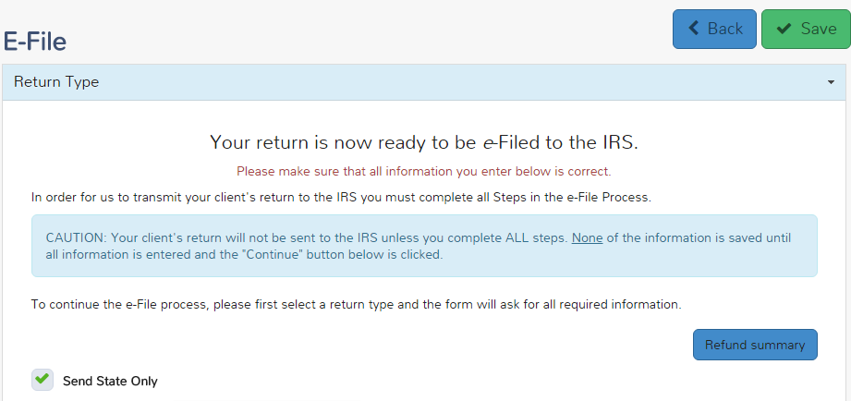
TS - E-File NJ Return Only - e-File section
Click on “Send State Only” to e-file NJ return only

Slide 15
TS - E-File NJ Return Only - e-File section
You will receive a warning if you choose to e-file
NJ return only
You will receive a warning if you choose to e-file a NJ return only

Slide 16
NJ Filing Income Threshold Filing Requirements
NJ 1040 Instructions
If your filing status is… | THEN file a return if your gross income (NJ line 28) was at least..
Single | $10,000
Married/Civil Union Partner filing joint return | $20,000
Married/Civil Union Partner filing separately | $10,000
Head of Household with qualifying child | $20,000
Qualifying widow(er)/surviving Civil Union Partner | $20,000
Notes:
This information is in NJ 1040 Instruction booklet
16

Slide 17
NJ State Return Do Not File
Review of Intake & Interview Form & tax documents clearly show that all below apply:
If ALL of the following conditions exist
Income is under filing threshold
No withholdings to be refunded
Homeowner (not a Tenant)
Not eligible for Earned Income Tax Credit (EITC)
Notes:
Tenants who are under the filing threshold should still file to get the $50 property tax credit

